Slide 1
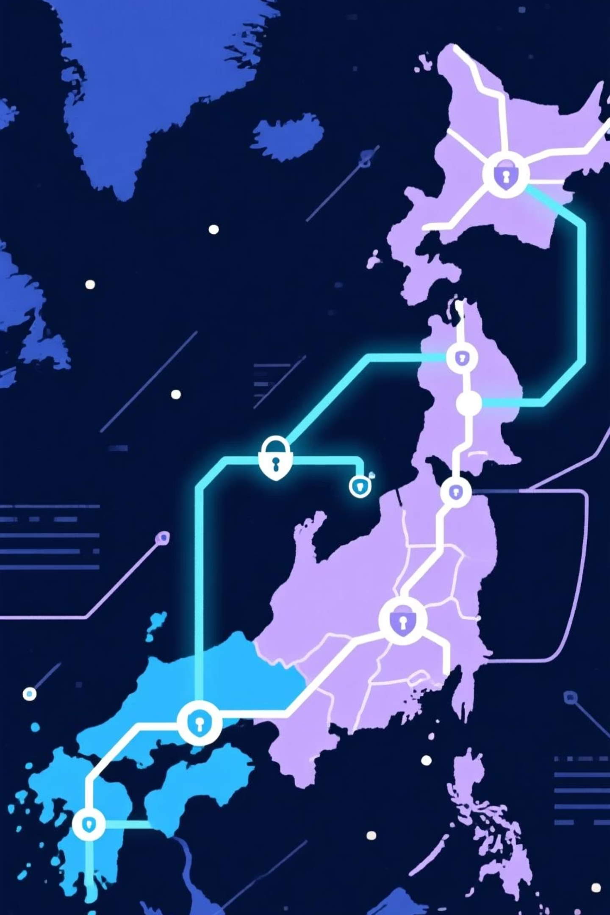
Enterprise Network Design for Multi-National Company
Optimizing Connectivity and Security Across Egypt & Saudi Arabia

Slide 2
Team
Abdelrahman Radwan
Abdelrahman Khaled
Mahmoud Safwat
Ahmed Mohamed Afifi
Mariam Dweidar

Slide 3
Project Overview: Building a Resilient Network
This project outlines the robust network infrastructure for a multinational enterprise with significant operations in Egypt and Saudi Arabia. Our design focuses on seamless connectivity, high availability, and stringent security across all locations.
2
4+
15+
Headquarters
Branch Offices
Network Devices
Strategic hubs in Egypt and Saudi Arabia.
Distributed across key regional cities.
Routers, switches, firewalls, and APs.

Slide 4

Network Architecture: A Holistic View
The proposed architecture integrates two primary Headquarters (HQ1 in Egypt, HQ2 in Saudi Arabia) and multiple branch offices. All sites will be interconnected via secure links, ensuring efficient data exchange and communication.
HQ1 & HQ2: Core network infrastructure, centralized services.
Branch Offices: Local network access with VPN connectivity to HQs.
VPN Tunnels: Encrypted communication channels between all sites.
Wireless Access: Secure Wi-Fi deployment for user mobility.

Slide 5



Security Implementation: Protecting Critical Assets
Our security strategy is built upon the pillars of Confidentiality, Integrity, and Availability (CIA), employing multi-layered defenses to safeguard the enterprise network.
Confidentiality
Integrity
Availability
Ensured through robust encryption (VPNs) and strict access controls.
Maintained via checksums, digital signatures, and secure data handling protocols.
Guaranteed by redundant systems and proactive monitoring.
Further reinforced by advanced firewalls and AAA (Authentication, Authorization, Accounting) for user and device access management.

Slide 6



High Availability: Ensuring Continuous Operation
Network uptime is paramount for multinational operations. Our design incorporates several mechanisms to eliminate single points of failure and ensure uninterrupted service.
VRRP (Virtual Router Redundancy Protocol)
Link Aggregation (Eth-Trunk)
Dual WAN Connections
Utilizes two separate internet service providers or circuits to prevent outages due to a single ISP failure.
Provides automatic failover for default gateways, ensuring network traffic continues even if a router fails.
Bundles multiple physical links into a single logical link, increasing bandwidth and providing link redundancy.

Slide 7
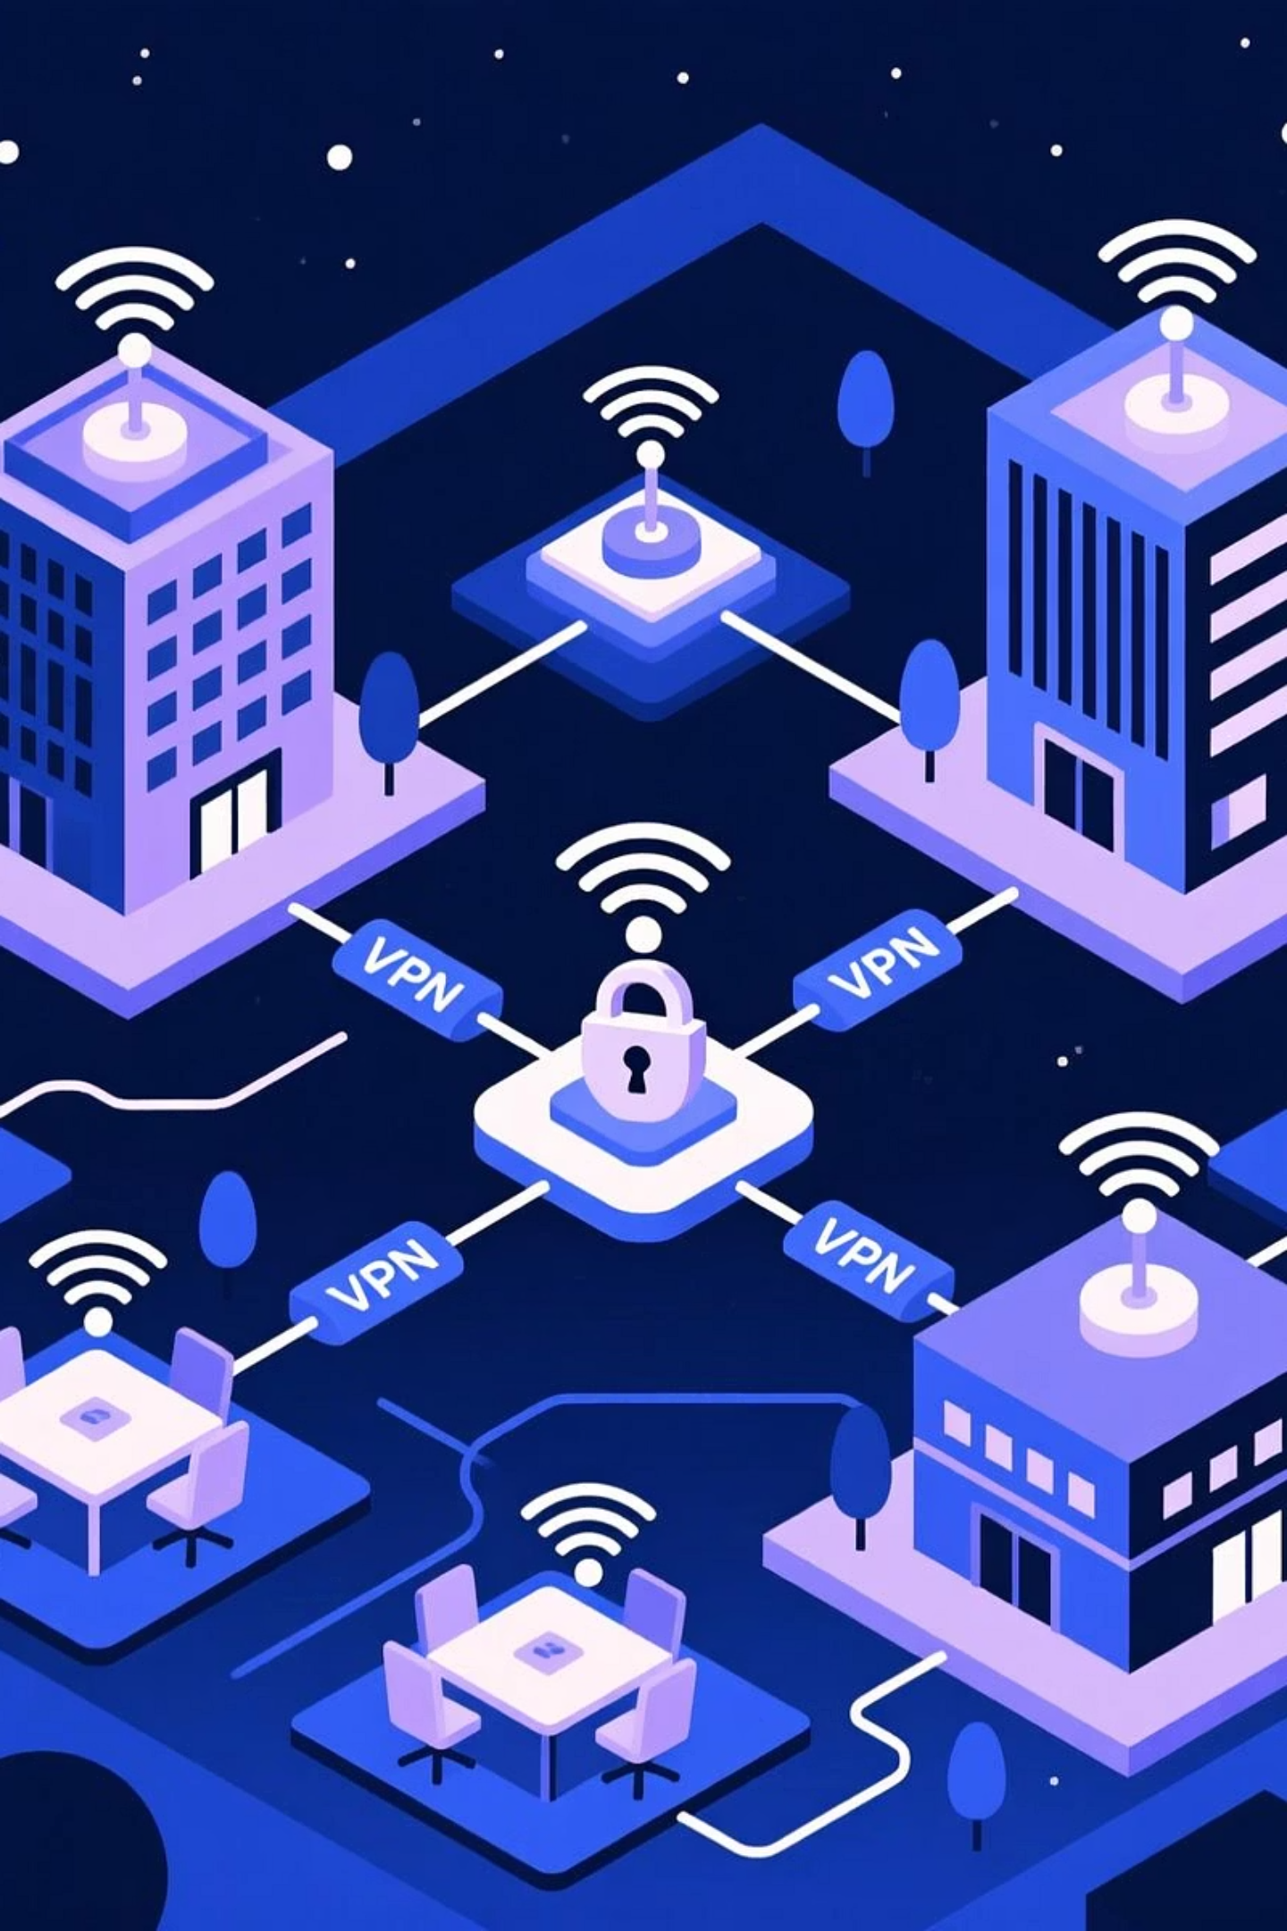
Routing Protocols: Dynamic Path Selection
Efficient and scalable routing is achieved through a combination of industry-standard protocols, adapting to network changes dynamically.
OSPF (Open Shortest Path First): Interior Gateway Protocol (IGP) for rapid convergence within each HQ and branch network.
BGP (Border Gateway Protocol): Exterior Gateway Protocol (EGP) for robust routing between the two Headquarters and for internet connectivity..

Slide 8




Network Services: Enhancing Performance and Management
A suite of essential network services is implemented to optimize performance, facilitate management, and support critical applications like VoIP.
SNMP (Simple Network Management Protocol)
NetStream
Provides detailed network traffic analysis and visibility.
For centralized monitoring and management of network devices.
QoS (Quality of Service)
VoIP Support
Prioritizes critical traffic like VoIP to ensure optimal performance.
Dedicated configurations to ensure high-quality voice communication.

Slide 9
IP Addressing & VLAN Plan
A structured IP addressing scheme and VLAN segmentation are critical for network organization, security, and broadcast domain management.
Location/VLAN
IP Subnet
Purpose
VLAN ID
HQ1 - Data
10.0.1.0/24
General Data Traffic
10
HQ1 - Voice
10.0.2.0/24
VoIP Traffic
20
HQ2 - Data
10.0.11.0/24
General Data Traffic
110
HQ2 - Voice
10.0.12.0/24
VoIP Traffic
120
Branches - Data
10.0.X.0/24
Branch Data Traffic
100+X
Branches - Voice
10.0.Y.0/24
Branch VoIP Traffic
200+Y
DMZ
172.16.0.0/28
Public-facing Services
900
VPN Links
192.168.0.0/30
Inter-site VPN Tunnels
--

Slide 10
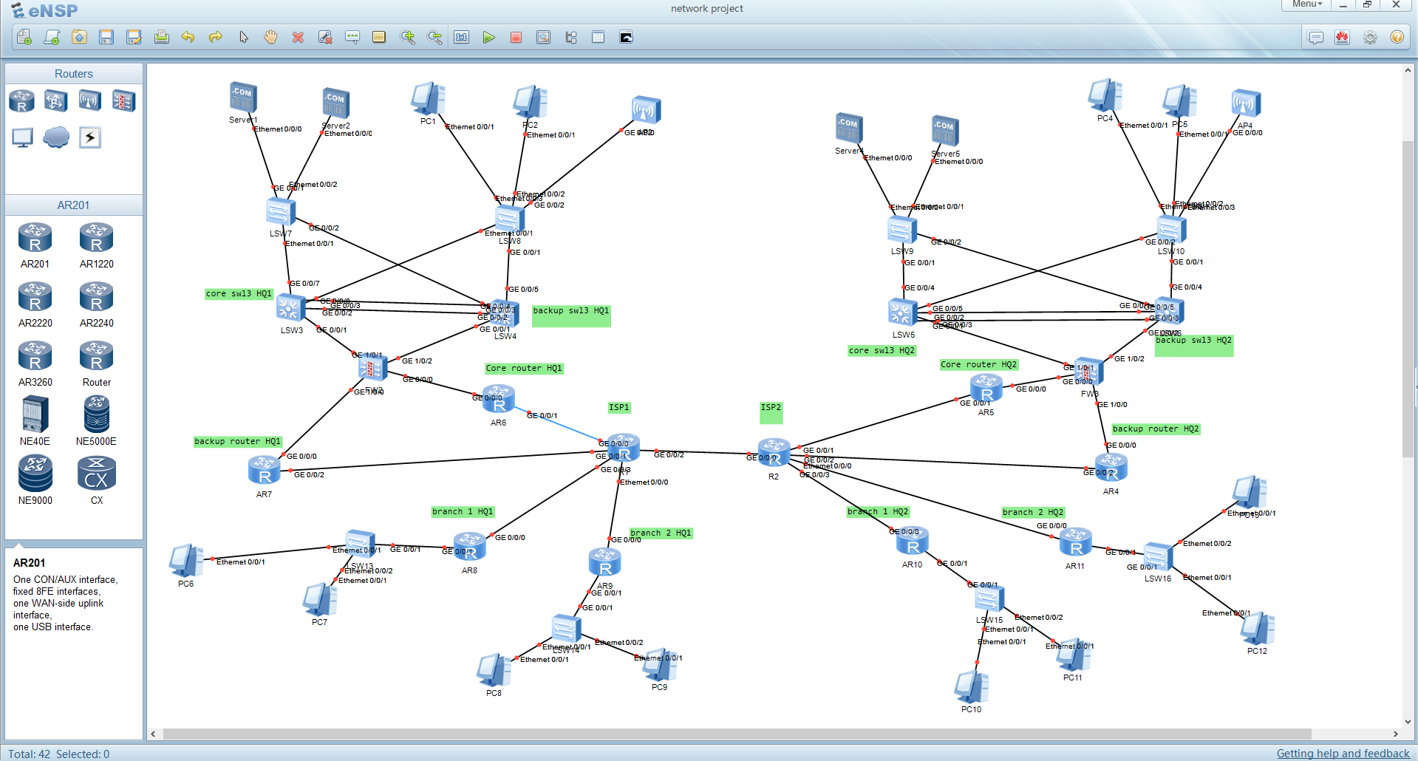
Topology

Slide 11
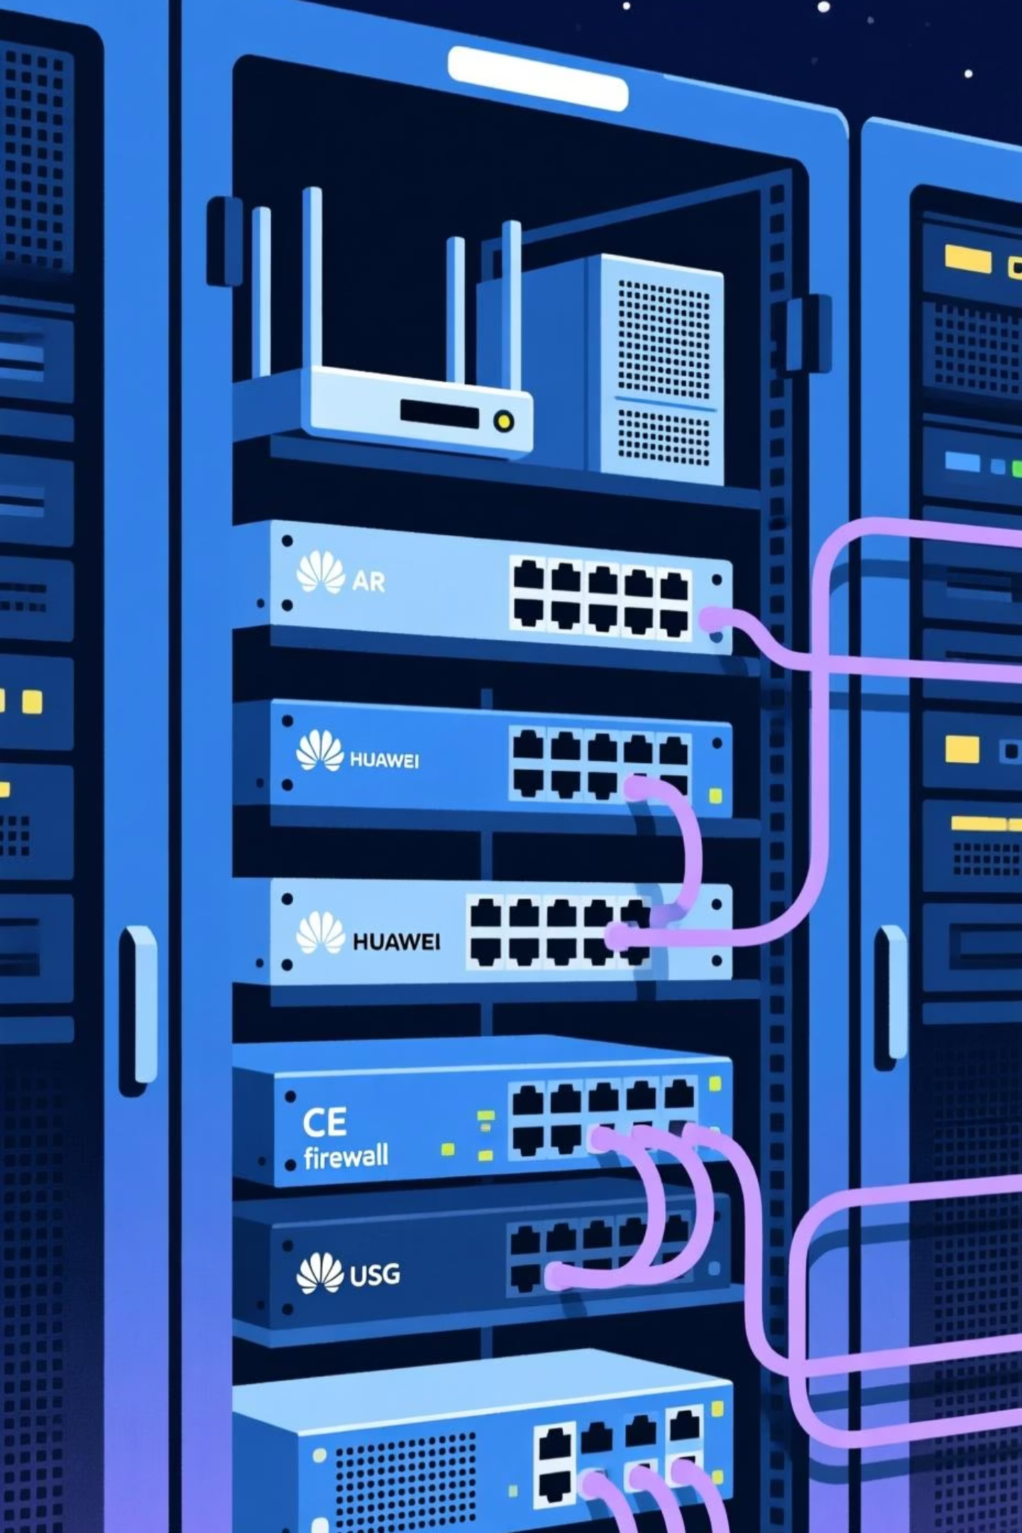
Learning Objectives & Technologies Used
Learning Objectives
Key Technologies Used
HCIA (Huawei Certified ICT Associate) - DataCom: Foundational knowledge for enterprise networking.
Huawei eNSP: Network simulation platform for design and testing.
Huawei AR Routers: Enterprise-grade access and aggregation routers.
HCIP (Huawei Certified ICT Professional) - DataCom: Advanced skills in planning, deploying, and troubleshooting complex networks.
Huawei CE Switches: CloudEngine series switches for high-performance data centers and campus networks.
Huawei USG Firewalls: Unified Security Gateways for comprehensive network protection.

Slide 12



Summary & Benefits: A Future-Proof Network
This enterprise network design delivers a robust, secure, and highly available infrastructure tailored for the demands of a multinational company operating in Egypt and Saudi Arabia.
Scalability
Security
Redundancy
Designed to effortlessly accommodate future growth and expansion of operations.
Multi-layered defenses protect sensitive data and ensure business continuity.
Eliminates single points of failure, ensuring maximum uptime and reliability.
By adopting this design, the enterprise will achieve superior network performance, enhance operational efficiency, and significantly reduce potential downtime.

